Slide 1
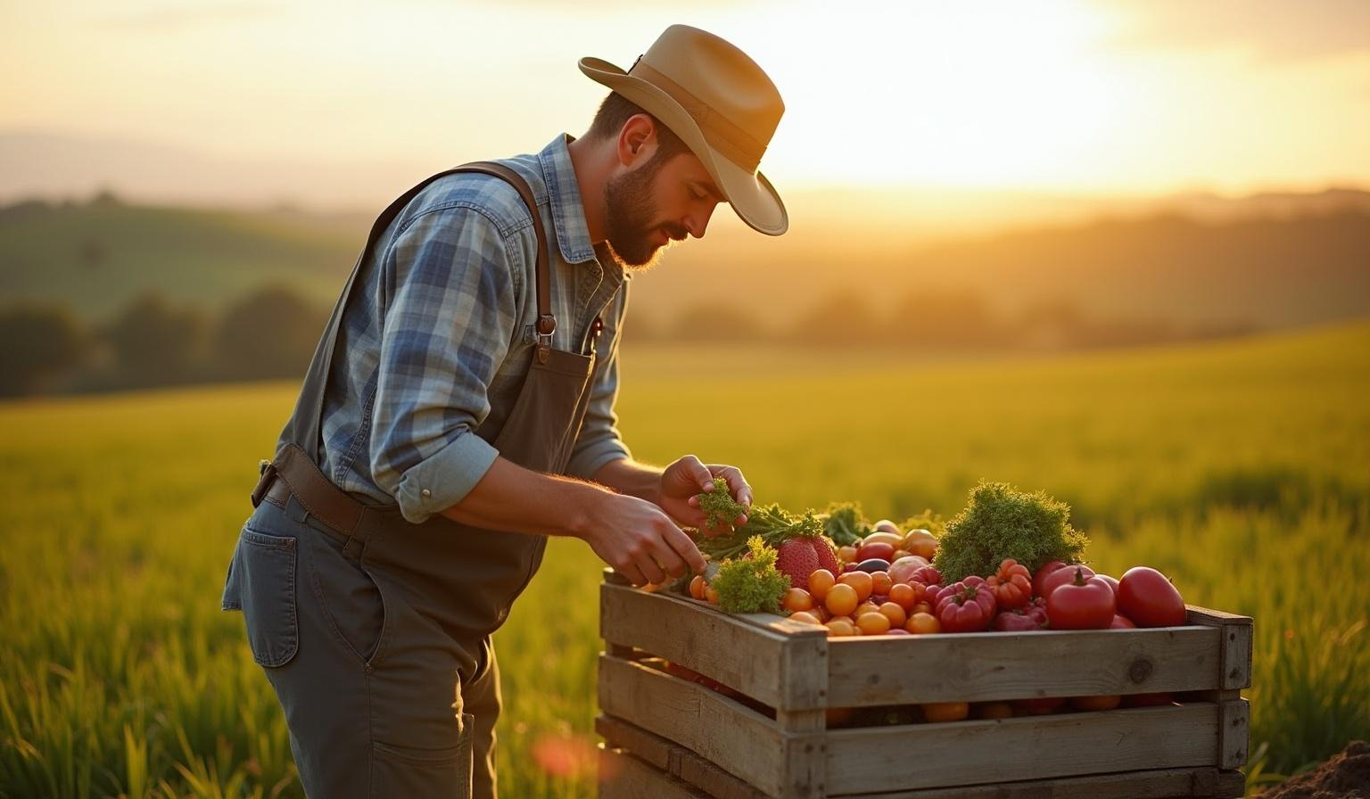
Value-Add Farming
Support for farmers to create higher-value products

Slide 2
Introduction
This presentation explores how to support farmers in producing value-added agricultural products to promote rural entrepreneurship. It highlights key concepts and types of value-added products farmers can develop to increase income and market opportunities.

Slide 3
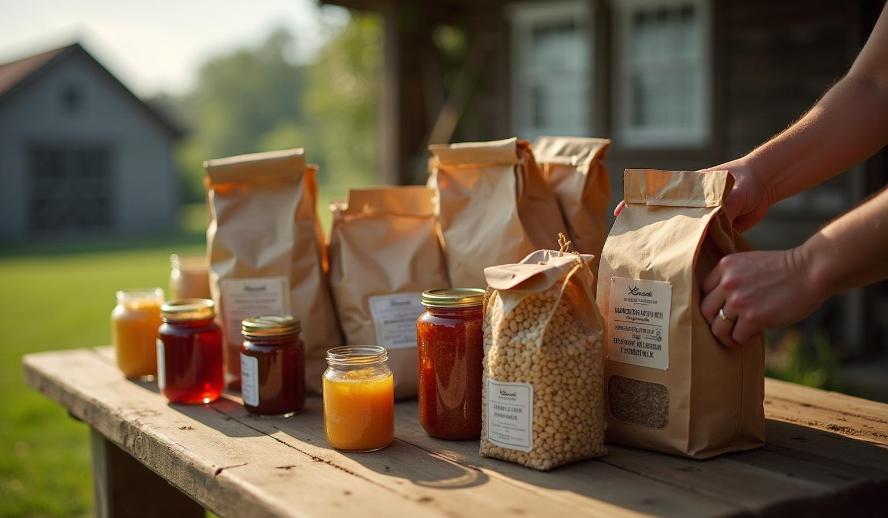
01
Value-Added Agricultural Products

Slide 4
Understanding Value Addition in Agriculture
Value addition transforms raw crops into more valuable products, such as processed foods or handmade goods, enhancing farmer income and market reach through innovation and diversification.

Slide 5
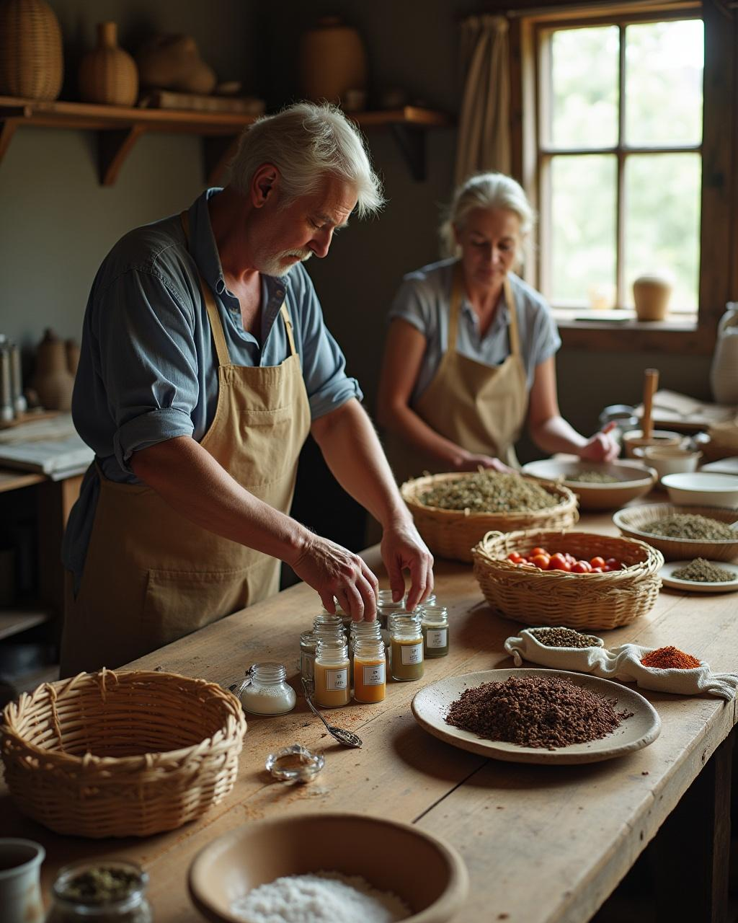
Types of Value-Added Products for Farmers
Farmers can produce processed foods, handicrafts, organic products, and specialty items that leverage local resources and skills to meet consumer demands for unique, high-quality goods.

Slide 6
Benefits of Producing Value-Added Goods
Producing value-added goods increases farmer income, creates jobs, and strengthens local economies by diversifying products and enhancing market competitiveness and sustainability.

Slide 7

02
Web App for Rural Entrepreneurship

Slide 8

Features Supporting Product Development
The app offers tools for product design, recipe management, cost analysis, and regulatory compliance to help farmers efficiently create higher-value products.

Slide 9
User Interface for Farmer Accessibility
Designed with simplicity, the app supports multiple languages, offline usage, and step-by-step guidance, ensuring accessibility for farmers with varied digital skills.

Slide 10
Integration with Market Access and Sales Channels
The platform connects farmers to local and online markets, providing marketing support and logistics solutions to expand sales opportunities and customer reach.

Slide 11
Conclusions
Supporting farmers with value addition and a dedicated web app fosters rural entrepreneurship, enhances product value, and drives sustainable economic growth in agricultural communities.

Slide 12
Thank you
Do you have any questions?
youremail@freepik.com
+00 000 000 000
yourwebsite.com
Please keep this slide for attribution

